Slide 1
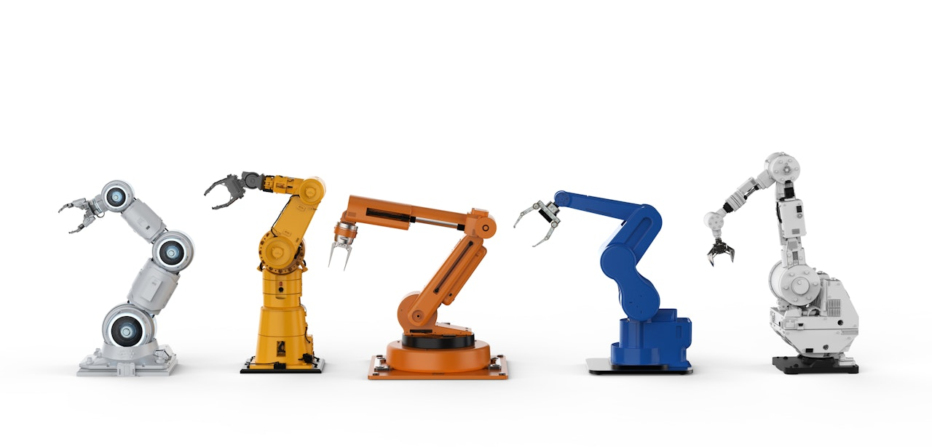
Industry 4.0 | End-to-End Traceability

Slide 2
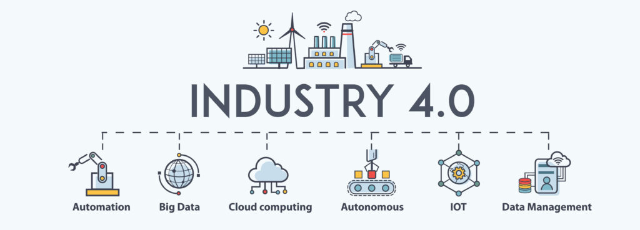
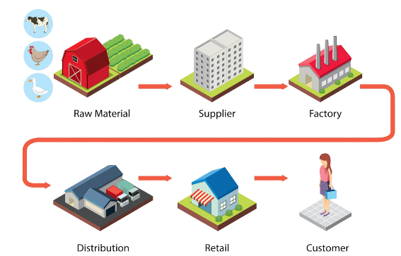

A brief about KURO
A Technology Company
Turnkey Solutions for Industry 4.0 IT-OT integration
End-to-End Value Chain Traceability
Vision
To build, evolve & adsorb robotics in the Manufacturing Industry at a Global Level.
Mission
To develop a stable economy by being a catalyst in making production processes reliable, efficient & easily tweakable.
Core Values
Customer Centric
Quality First
Reliability
Work Transparency

Slide 3





Our Offerings
IoT | IIoT
IT-OT
Integration
Digital Twin
Traceability of the Value Chain
Edge Computing

Slide 4
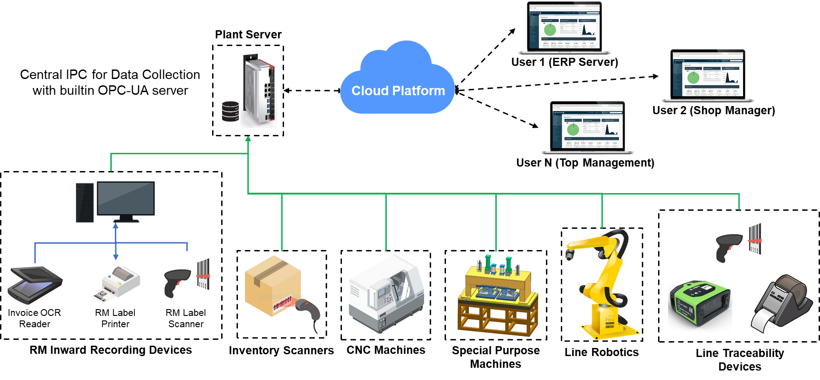
Standard Architecture

Slide 5
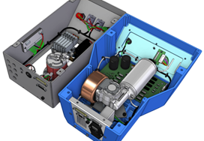
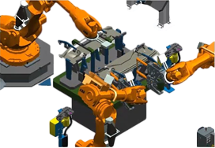
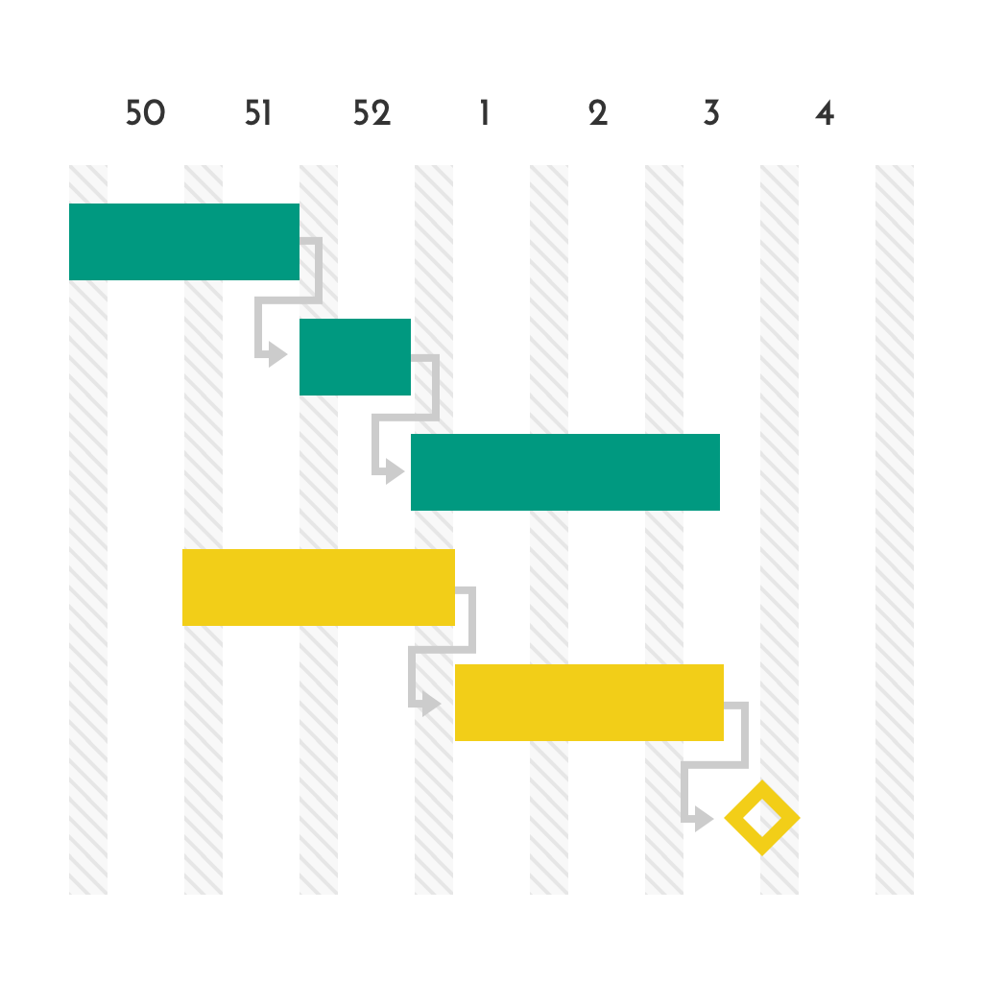



Competencies
Integrated Architecture Design
Virtual Commissioning & Simulation
Agile Project Management
Research & Testing Setup of 6000 sq. ft.
Remote Support Team
Continuous Innovation & Improvement

Slide 6


Accolades
Fit for Partnership, GIZ, Germany

Slide 7

Projects Executed

Slide 8
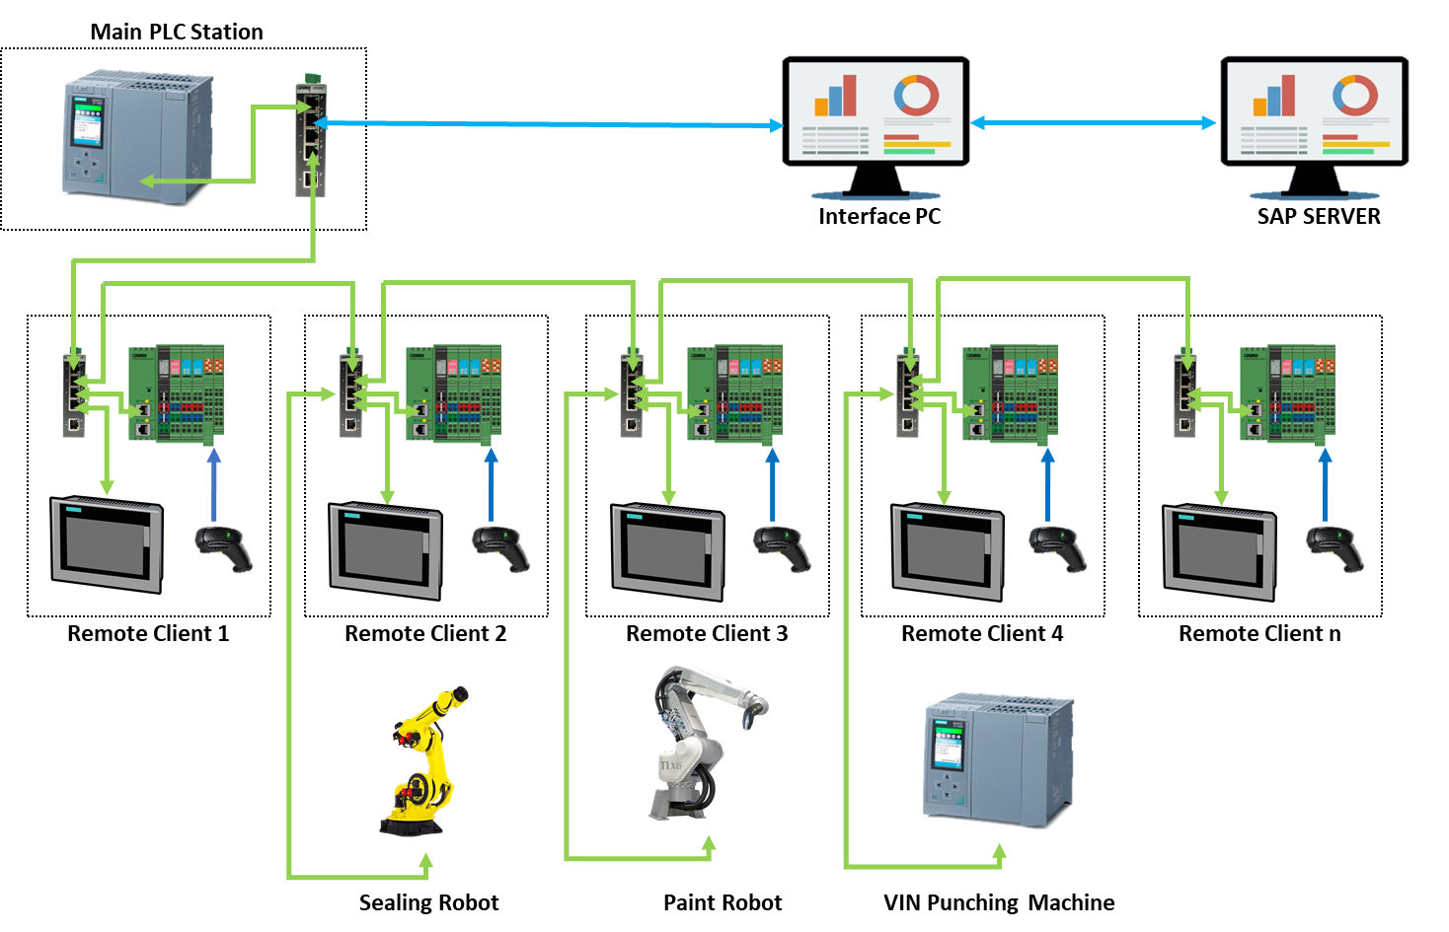
End to End Traceability Car Industry
Case : End to End Traceability for Vehicle Production Line
Automatic data encoding in barcode as per Production Schedule in SAP
Application Level Stations send process data variables to Robot and Machine Controllers
Realtime monitoring with deviation notifications to users by email
Automatic OEE Reporting and PM Notification

Slide 9
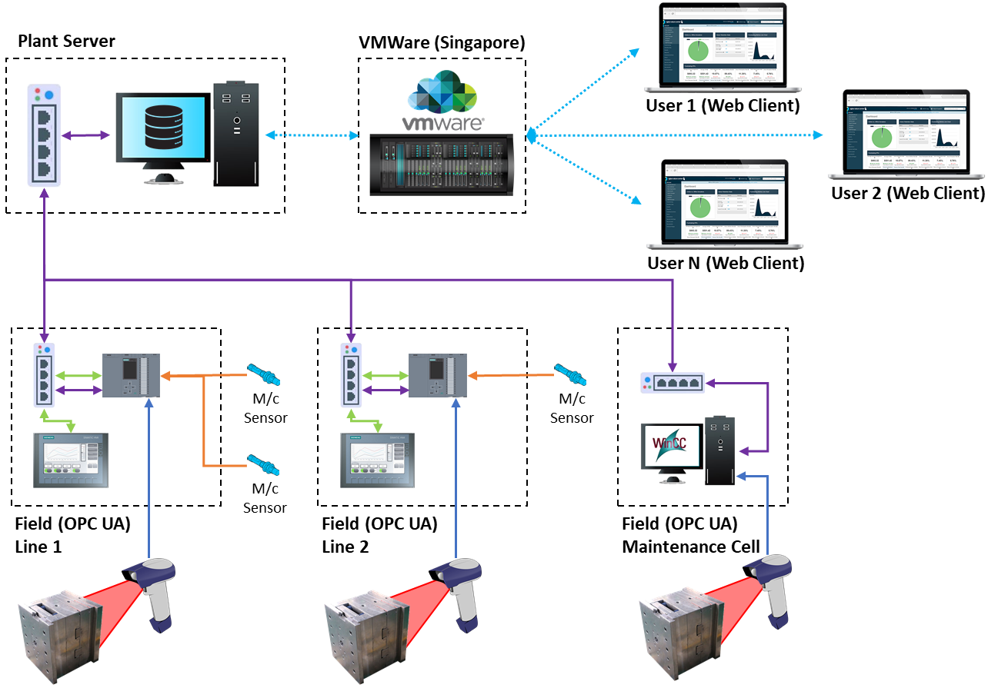
Maintenance & Utilization Traceability Automotive Ancillary
Case : Maintenance & Utilization Traceability for Moulding Die
Edge Computing using OPC-UA communication
Maintenance checklist verification in maintenance cell
Integrated Die condition Poka-Yoke with Moulding Machines
User specific dashboard & access control

Slide 10
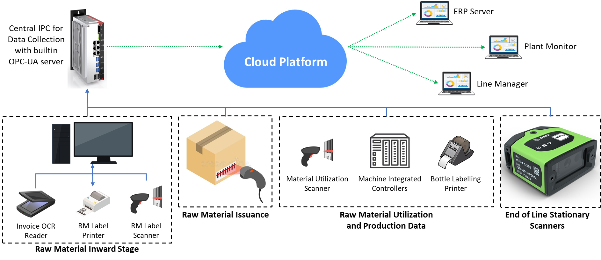
RM & Production Traceability FMCG Industry
Case : Raw Material to End of Line Production Traceability
Application proven for Nano-Factory which makes multiple products on single line in lots
User-friendly information addition in the system
Purely manless data entry from start to end using AI tools

Slide 11




















Clientele

Slide 12




THANK YOU
https://kurosystems.net/
+91 8956014041
info@kurosystems.net

